Slide 1
50M56U-751 IFC
Direct OEM Replacement
Carrier / ICP Single Stage IFC

Slide 2
Business and Product Overview

Slide 3
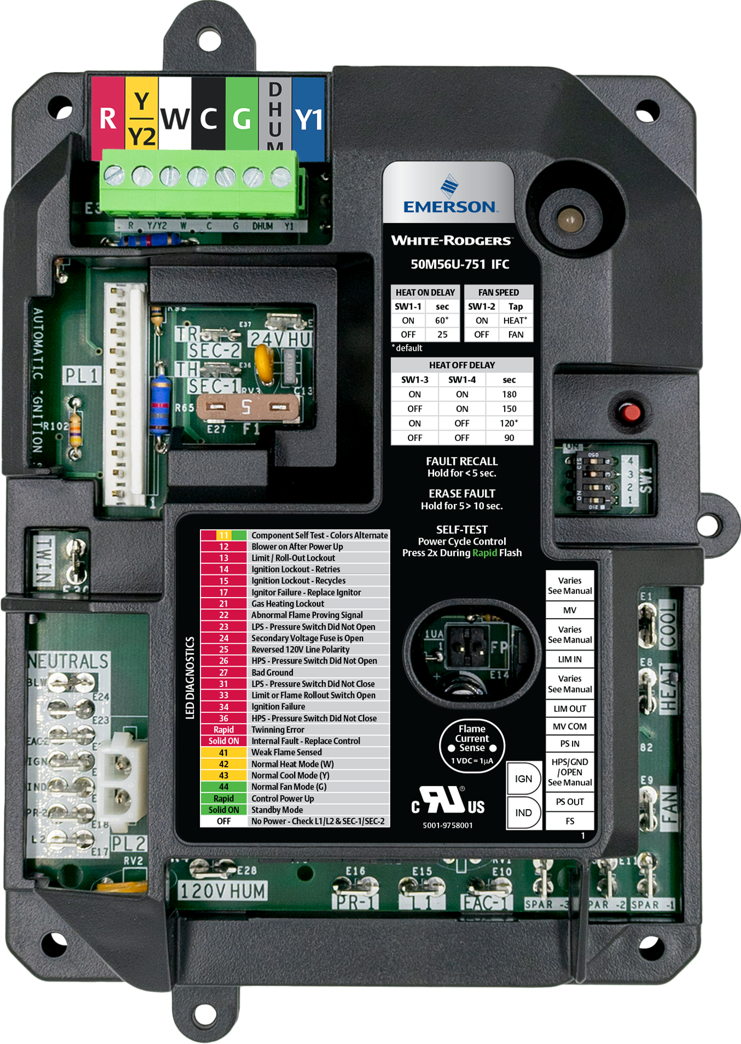
White-Rodgers 50M56U-751 IFC
Upgraded in 2020, the 50M56U-751 Integrated Furnace Control offers a direct replacement option for 33 controls in the Carrier/ICP family. Replacing an estimated 10 Million units, across the US*.
Including
Carrier Single Stage + PSC
  (1994-2019)
ICP Single Stage + PSC
  (2005-2019)
50M56U-751
Plus, the 50M56U-751 offers:
Tri-Color LED
Fault Recall
Easily-accessible Flame Current Test Pins
*-White-Rodgers Internal Projections

Slide 4
Replace More Parts with One SKU
Competitive Comparison:
 | White-Rodgers | Carrier/ICP | ICM282A
Cross Reference Coverage | 1 Control for 33 Cross Refs | 5 Controls for 33 Cross Refs | 1 Control for 7 Cross Refs
OEM Mounting | ✔ | ✔ | ✔
Tri-Color LED | ✔ | ✘ | ✘
Fault Recall & Clearing | Simple Push Button | Jumper Twin & C Terminals | 1 Fault Only
Robust FR4 PCB Material | ✔ | ✘ | ✔
Component Self Test Mode | ✔ | ✔ | ✔
Flame Current Test Pins | ✔ | ✘ | ✘
Constant Fan Speed & Dehum Mode | Included | 1 Control Only | ✘
No Harness for Most Applications | ✔ | ✔ | ✘
Cross Reference:
Carrier/ICP Brands 1172550 1183599 1184594 1184783 1186024 1186115 | 325878-751 CEPL130437-01 CEPL130437-01-1 CEPL130438-01 CEPL130590-01 CEPL131004 CEPL131004-02 | CEPL131004-20 CEPL131004-20-ICP CEPL131012-01 CEPL131012-01-1 CEPL131012-02 CEPL131012-02-1 CEPL131012-20 | HK42FZ004 HK42FZ007 HK42FZ008 HK42FZ009 HK42FZ011 HK42FZ013 HK42FZ016 | HK42FZ018 HK42FZ034 HK42FZ036 HK42FZ045 HK42FZ061 HK42FZ062 | ICM ICM282A Johnstone L43-837 L47-385 | White-Rodgers 50M56-751 50M56U-751
(SKU’s with boxes around them are old “White Cover” cross references)

Slide 5
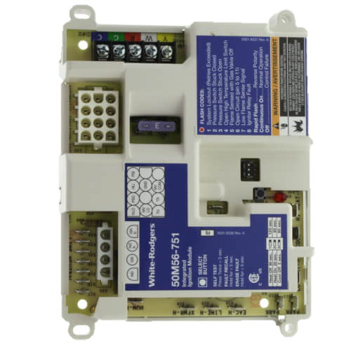
Product Improvements
To improve the installation experience and increase our cross references, White-Rodgers has made significant product improvements.
New ICP Harness
12 Pin Molex Upgraded to 11-Pin In-Line Connector
4 Pin Inducer/Ignitor Molex Upgraded to 2-Pin
24v Detachable Thermostat Bus + Y2 and Dehum I/O
24v or 120v Humidifier
Fan-Only Speed Dipswitch
Flame Current Test Pins
Twinning
Mounting options
Then,
White Cover
Now,
Black Cover
*WR Estimate

Slide 6
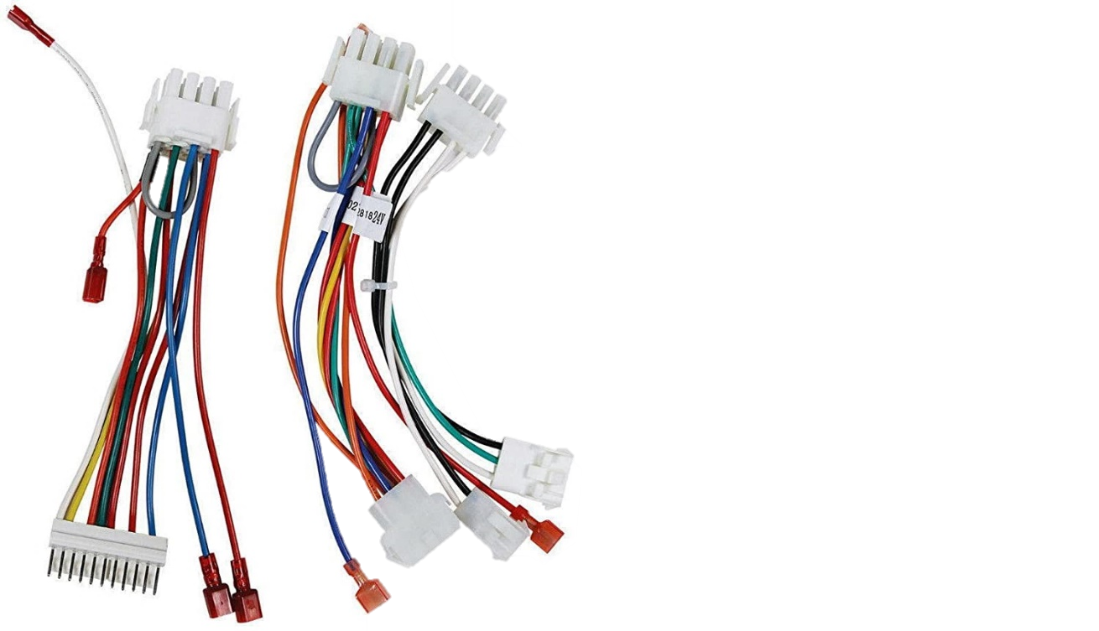

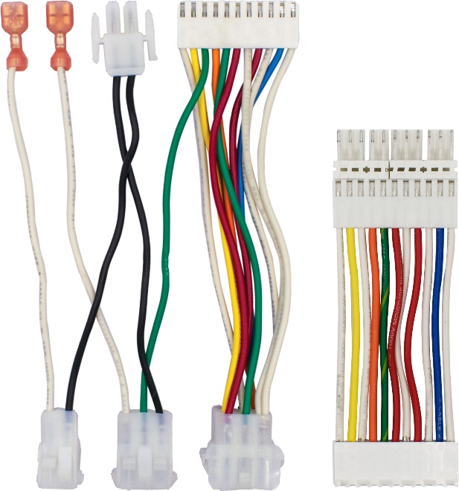

Improved Adapter Harnesses
2 Previous “White Cover” Harnesses
2 New “Black Cover Harnesses
Harnesses connect to the old controls 12 pin Molex plug.
Harnesses connect to the new controls 11 pin in-line plug.
  Eliminates secondary harness
  New "Flip Harness" provides ICP compatibility
TECH TIP: With the majority of existing Furnace Harnesses being 11 pin connectors, the new control will not need any adapter!

Slide 7
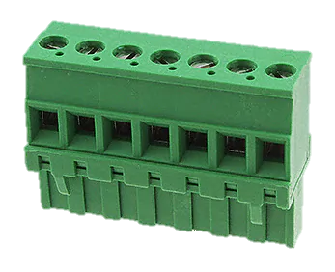
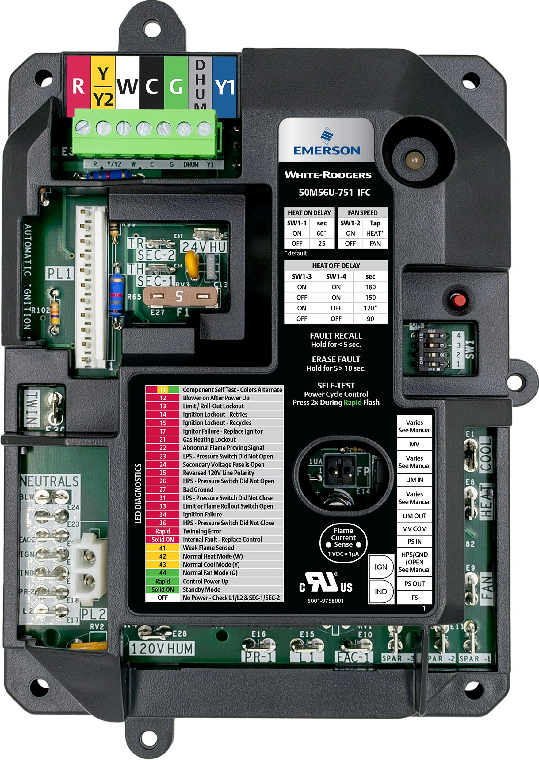
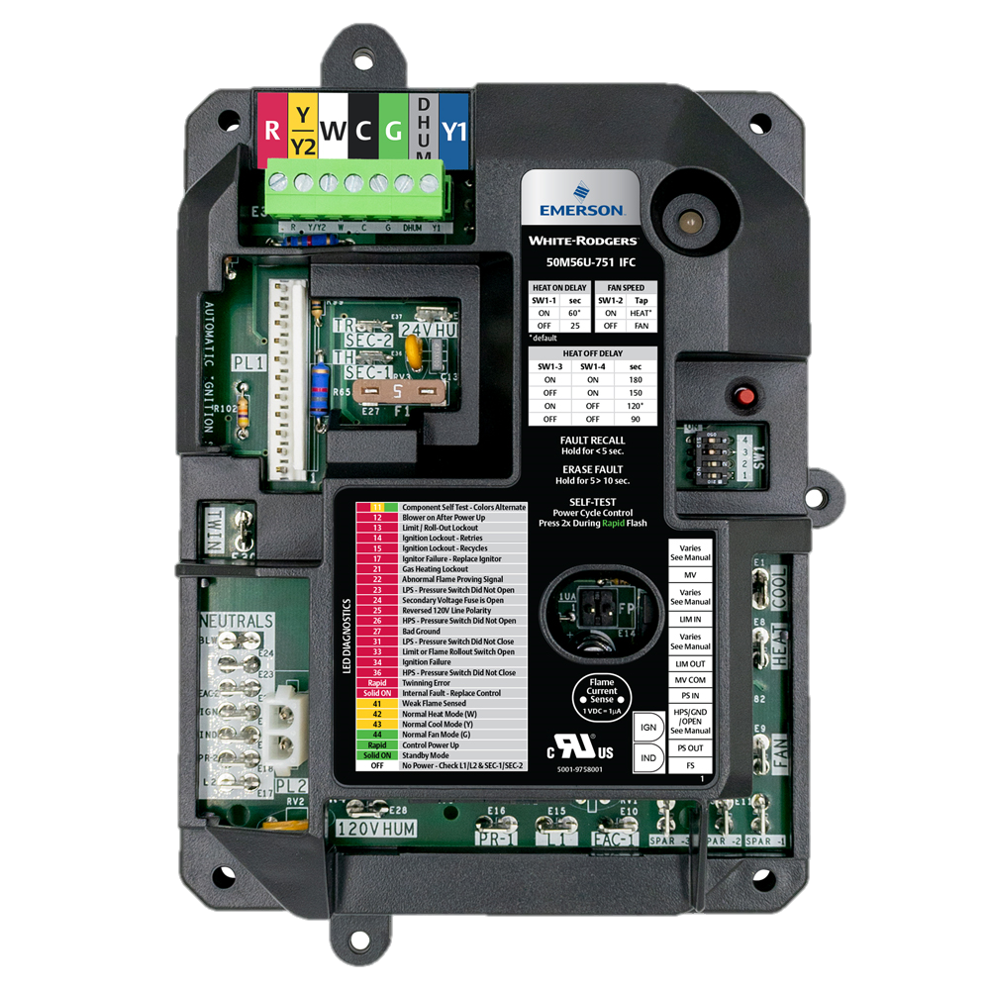
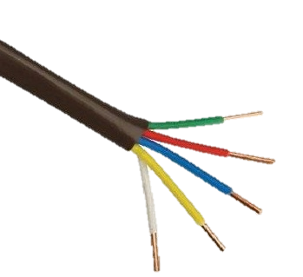

Key Features
Detachable T-Stat Bus
24v Humidifier Spade
Y2/Dehum
Bus disconnects from the control to allow for easy thermostat wiring.
The “white cover” control allowed for 24v humidification through an adapter harness. The new “black cover” has a designated spade on the control.
Two-stage outdoor cooling ready
Dehum terminal for lower blower speed

Slide 8
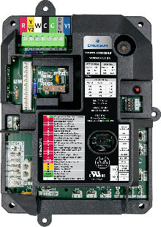
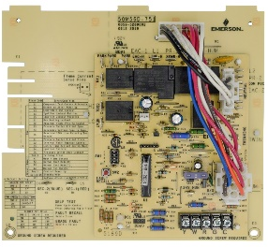
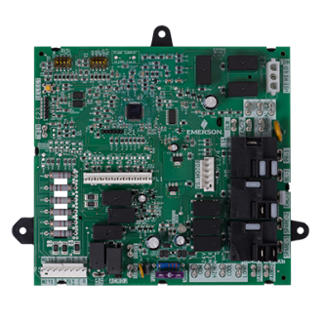
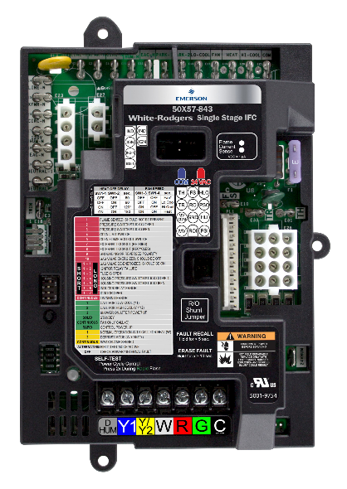
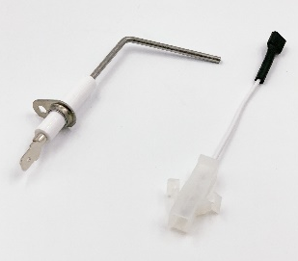
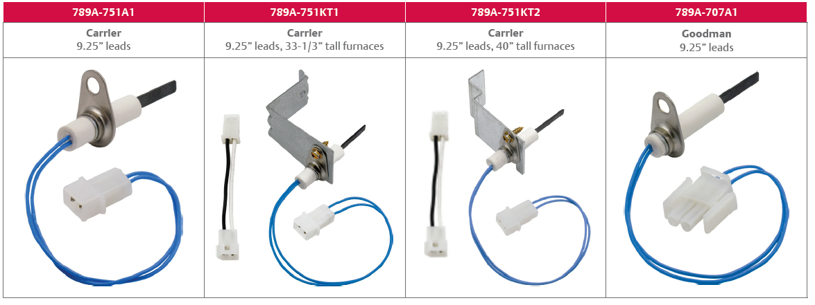
White-Rodgers HSI Gas Furnace Components – Carrier Family
CARRIER
CARRIER
CARRIER
CARRIER/UNIVERSAL
50M56U-751
50M56D-751
21V51D-751
50X57-843
IFC - PSC
IFC - PSC
IFC – 2 Stage
IFC - ECMx
CARRIER / ICP
CARRIER / ICP
CARRIER ICP
CARRIER / ICP
790-751A1
789A-751A1
789A-751KT1
789A-751KT2
Flame Sensor
Ignitor
Ignitor Kit – 33 1/3”
Ignitor Kit – 40”

Slide 9

Rest Assured, We Know The Industry
Automatic Configuration
  50M56U-751 matches its functional operation to the OEM controls being replaced.
  System design variations, such as with or without a Housing Pressure Switch, are automatically recognized and properly handled.
Enhanced Code 31 Software
  50M56U-751 features automatic recovery from intermittent high wind conditions without going into an unnecessary 3-hour lockout.

Slide 10
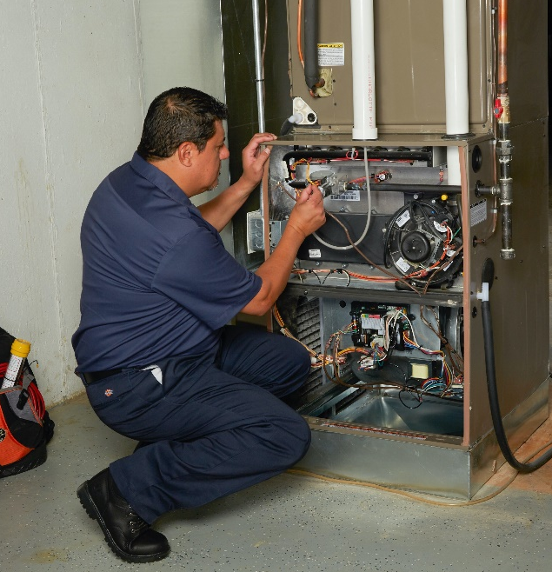
What Our Customers are Saying About 50M56U-751 IFC
“I was so impressed with this furnace circuit board. I installed it in a generic Carrier type brand furnace. It came with necessary wiring harnesses for each type of furnace and the install was a piece of cake.”
- January, 2020
“This White Rodgers board is an excellent replacement board that comes with a nice plastic cover protecting it from the elements. The instructions were simple to follow and this was an easy installation.”
July, 2019
“This was very easy to install when using the instruction booklet, which is included. Everything is step by step and the LED diagnostic helps guide you if you've made a mistake.”
December, 2018

Slide 11

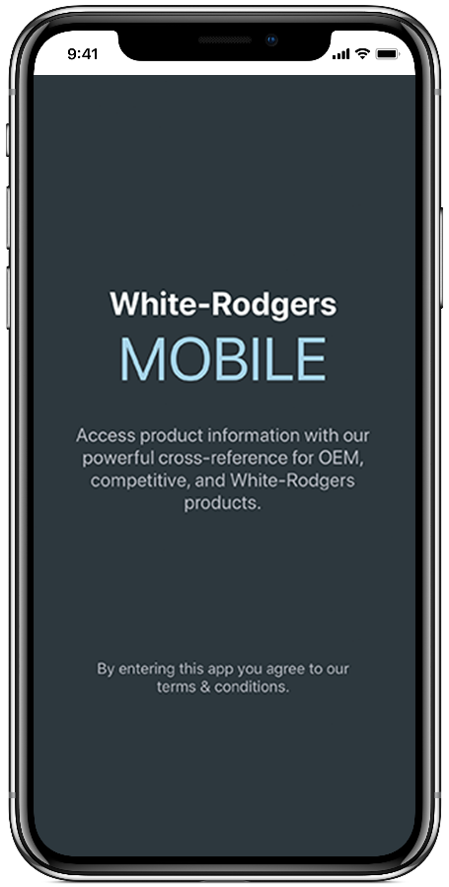



WR Mobile App
Always up-to-date and easy to use:
Mobile App
White-Rodgers Website
Your resource for:
Product information and spec sheets
Complete Cross Reference
OEM compatibility
Installation information and videos
Wiring diagrams
Download:
Go to your app store
Type in WR Mobile
Install the app
OR
Open your camera
Hold it over the QR code
Tap “Open” on the
pop-down
Install the app

Slide 12
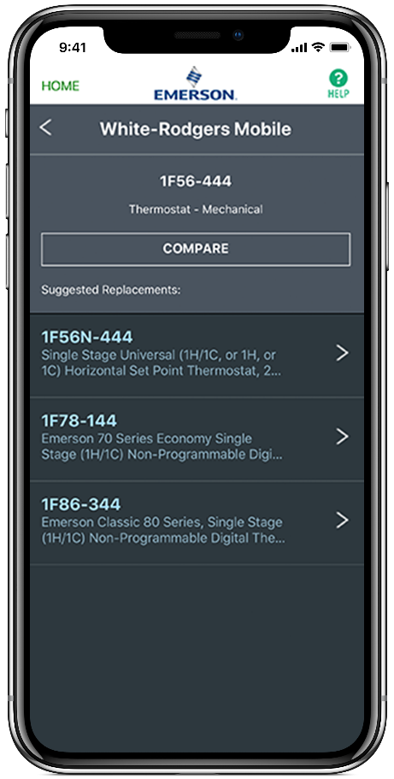
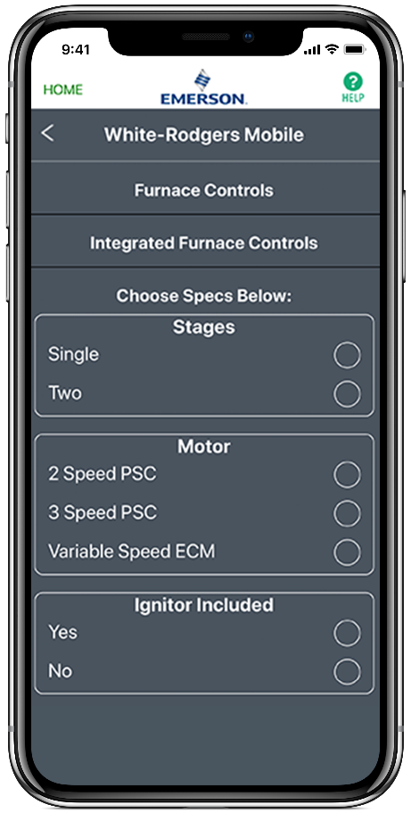
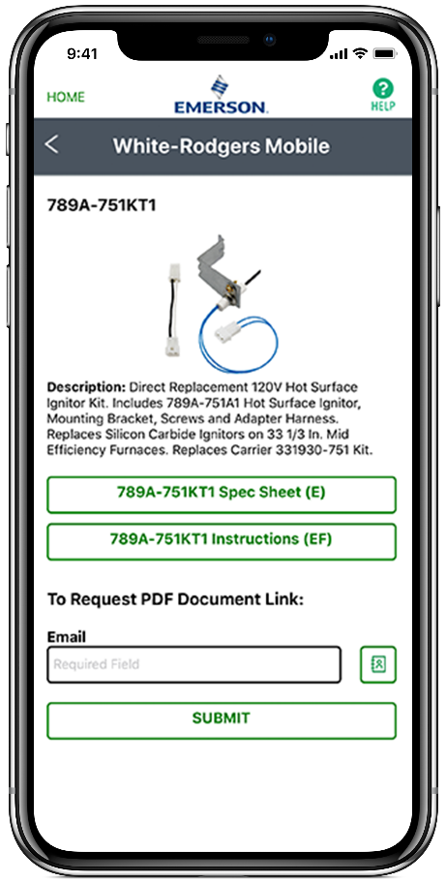
WR Mobile App
Easy to use!
Search by OEM, Competitive, or White-Rodgers Model Number
Product Number
Scrollable Product List
WR Replacement

Slide 13

White-Rodgers Cross Reference
Go to: www.whiterodgers.com
Hover over Tools & Resources
Click on: White-Rodgers Cross Reference/Product Information
Enter the Model Number or click on: Search Replacement Heating Controls by Major OEM Brand

Slide 14
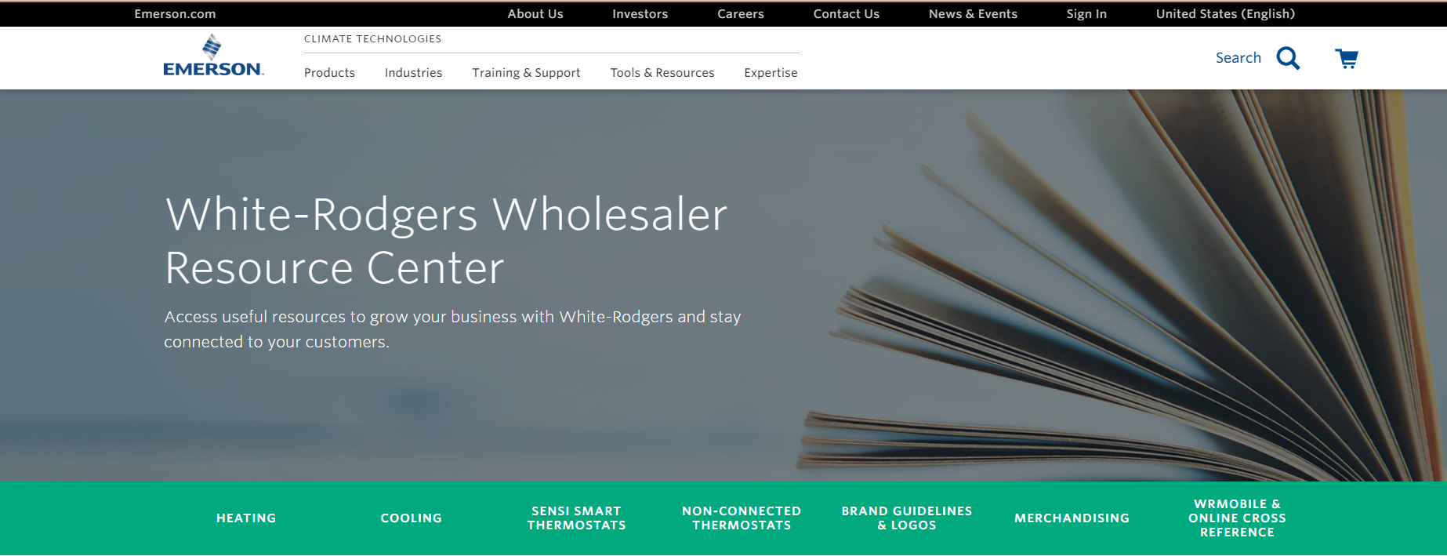
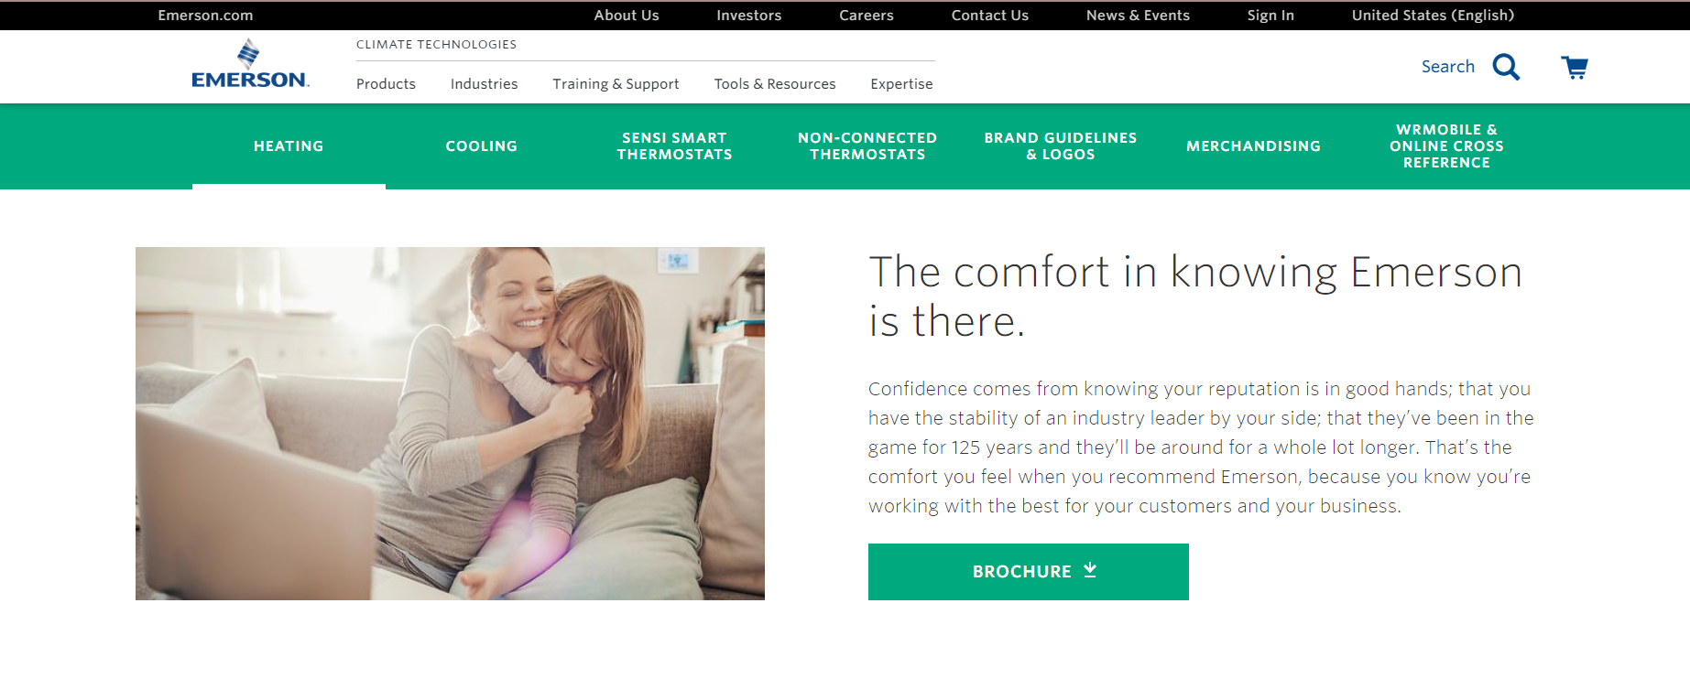
Wholesale Resource Site
Access useful resources to grow your business.
Visit: https://climate.emerson.com/en-us/brands/white-rodgers/white-rodgers-wholesaler-resource-center
You’ll find videos, stocking lists and product launch information for the following product families:
Heating Controls
Cooling Controls
Sensi Smart™ Thermostats
Traditional Thermostats
Contractor Rewards
Product Merchandising

Slide 15
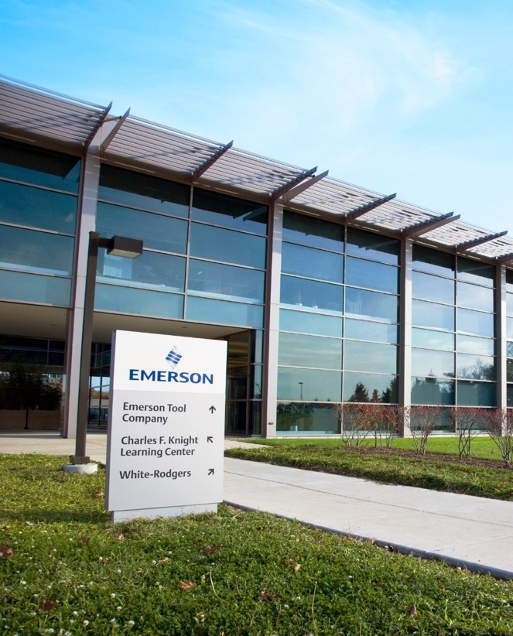
Why Contractors Trust White-Rodgers
Industry Leading Products
Used by more OEM’s
Offering the widest range of Universal Replacement Controls
Ease of Installation
Simple, easy to understand instructions
Product Reliability
Quality Control assures reliable products
Affordable
Competitive pricing
Supported by Knowledgeable Representatives
Contractor direct phone support

Slide 16
Technical

Slide 17
White-Rodgers 50M56U-751 IFC
Upgraded in 2020, the 50M56U-751 Integrated Furnace Control offers a direct replacement option for 33 controls in the Carrier/ICP family. Replacing an estimated 10 Million units, across the US*.
Including
Carrier Single Stage + PSC
  (1994-2019)
ICP Single Stage + PSC
  (2005-2019)
50M56U-751
Plus, the 50M56U-751 offers:
Tri-Color LED
Fault Recall
Easily-accessible Flame Current Test Pins
*-White-Rodgers Internal Projections

Slide 18
White-Rodgers Carrier 50M56U-751 Components
24V Components:
Removable 24V Thermostat Bus
Status/Fault LED
11 Pin Inline Connector
Twinning Spade
24V Transformer Spades
24V Humidifier Spade
5a Low Voltage Fuse
Fault Recall Button
Heat On/Off, Fan Dipswitches
Flame Sense Test Pins
3 Tab or 4 Corner Mounting Options
120V Components:
PSC Blower Heat Spade
PSC Blower Cool Spade
PSC Blower Fan Only Spade
3 Extra Blower Speed Park Spades
120V EAC Spade
120V to Transformer Spade
Line 120V Input Spade
120V Humidifier Spade
7 Line Neutral Spades
2 pin Inducer/Ignitor Molex Plug
1
2
3
5
6
8
7
9
4
10
13
21
12
14
20
19
18
17
16
15
11
50M56U-751

Slide 19
Test Pins
2 pins extend from the Control Board to the surface of the Black Cover.
To Test:
The furnace must have a call for heat + burners producing flame.
Set a multimeter to vDC and place a meter probe on each pin.
Convert vDc to MicroAmps using a 1:1 ratio.
A good flame sense reading will be between 1.0 – 5.0 μA.
50M56U-751

Slide 20
Twinning
Two 50M56U-751 Controls can be connected to operate simultaneously.
Twinning requires a connection of the Twin Terminal on both boards using an 18ga wire.
The Board with the Thermostat connection will fully function including the LED indicator and Dipswitch settings.
The Twinned Board will operate simultaneously as determined by the wired board unless “W” or “Y” are powered to it.
The Twinned unit can be wired for Heat to come on by utilizing the “W” terminal either with the 1st unit or as a 2nd stage.
50M56U-751

Slide 21
Mounting Options
The raised molded base provides space between board and unit mounting plate. With two unique mounting options.
Option 1
3 tabs match some OEM models with a tray.
  3x ½” screws are provided
Option 2
4 mounting holes that match some OEM boards give additional options for alternate mounting.
  4x 1” screws are provided
3 mounting tabs match existing boards for easy replacement.
4 mounting holes match some OEM boards for alternate mounting.

Slide 22
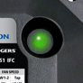
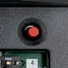
Status & Fault Codes for Troubleshooting
Tri-Color LED
Fault Button Offers:
  5 Fault Recall
  Fault Code Erasure
  Self-Test Mode
Troubleshooting made easy with a Fault Code Label on the control cover.
50M56U-751
Updated Fault Code 31 Software
Notes:
The software code has been modified with new pressure switch criteria. When the pressure switch trips 3 times, there is a 3-hour lock-out.

Slide 23
Install

Slide 24
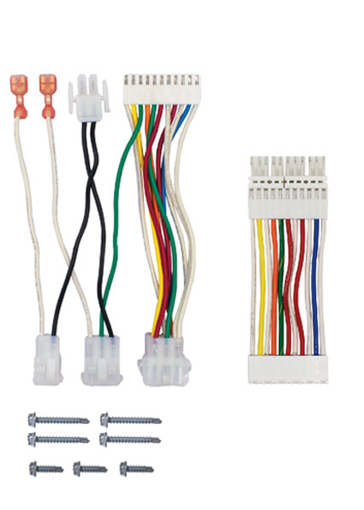
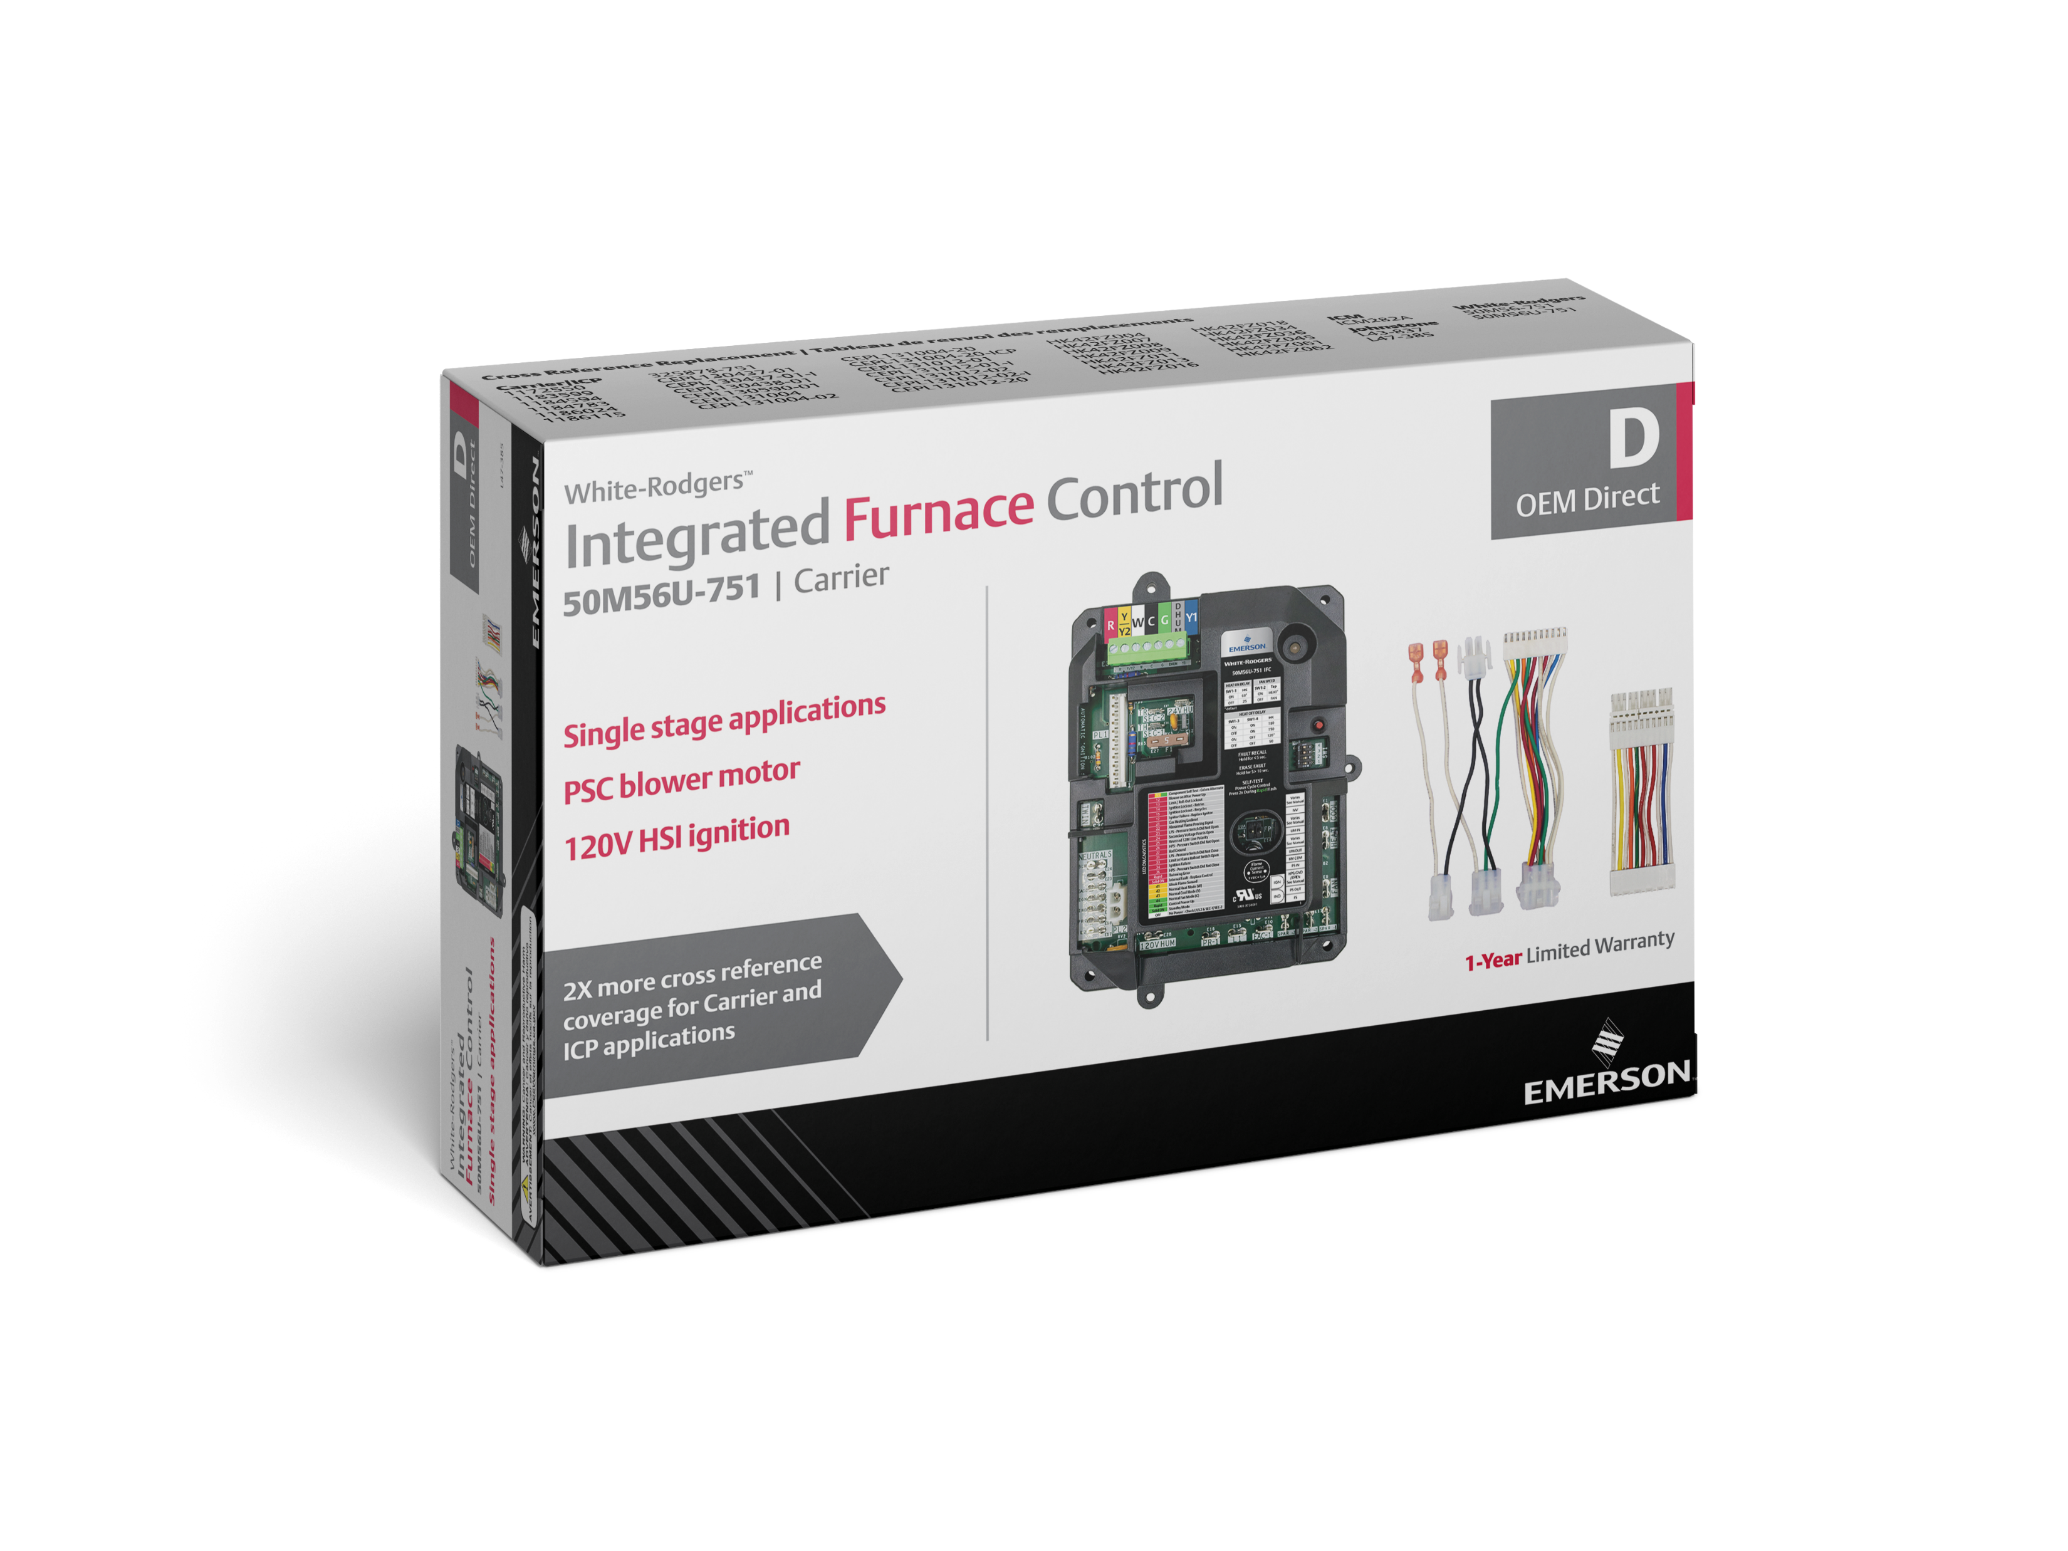
What’s in the Box?
50M56U-751 Integrated Furnace Control
9-Pin Adapter Harness
“Flip” Adapter Harness for ICP
4 – 1” Sheet Metal Screws
3 – ½” Sheet Metal Screws
Installation Instructions
TECH TIP: Smaller box in the new 50M56U-751 for additional truck space.

Slide 25
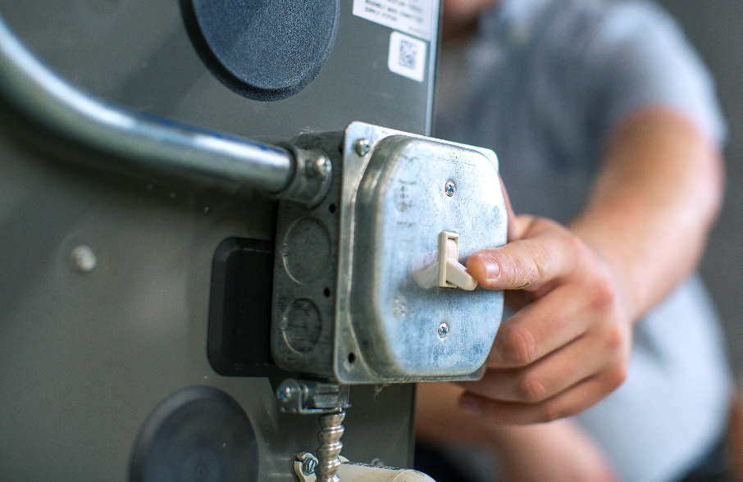
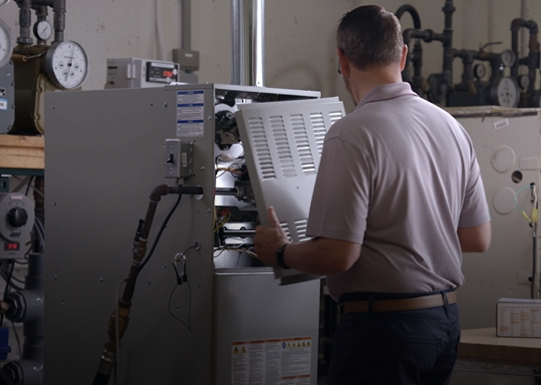
Installation – Step 1
1
Turn off the power and gas to the furnace and remove the access panels.

Slide 26
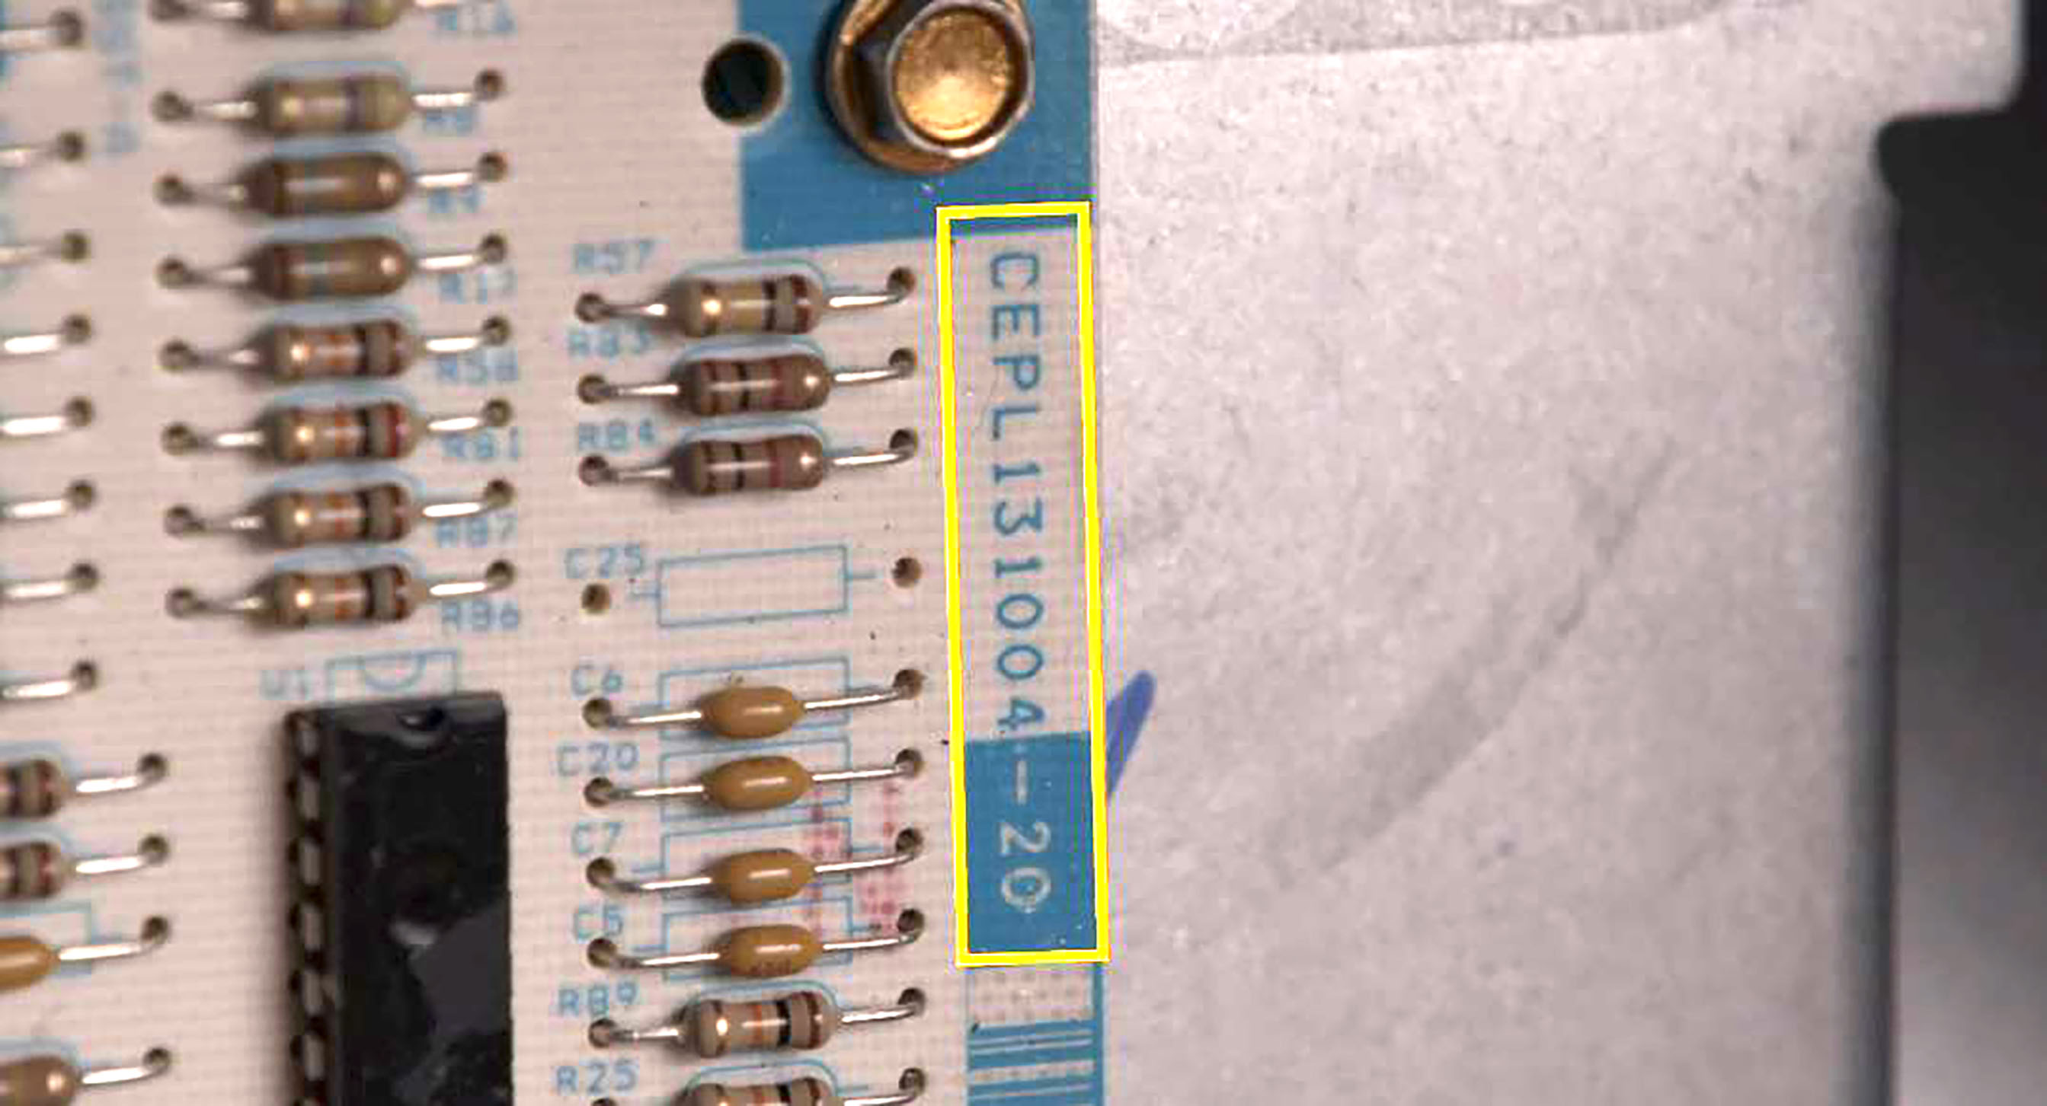
Installation – Step 2
2
Check the part number on the part replaced against the 50M56U-751 Cross Ref on the package or on the White-Rodgers Mobile App.

Slide 27
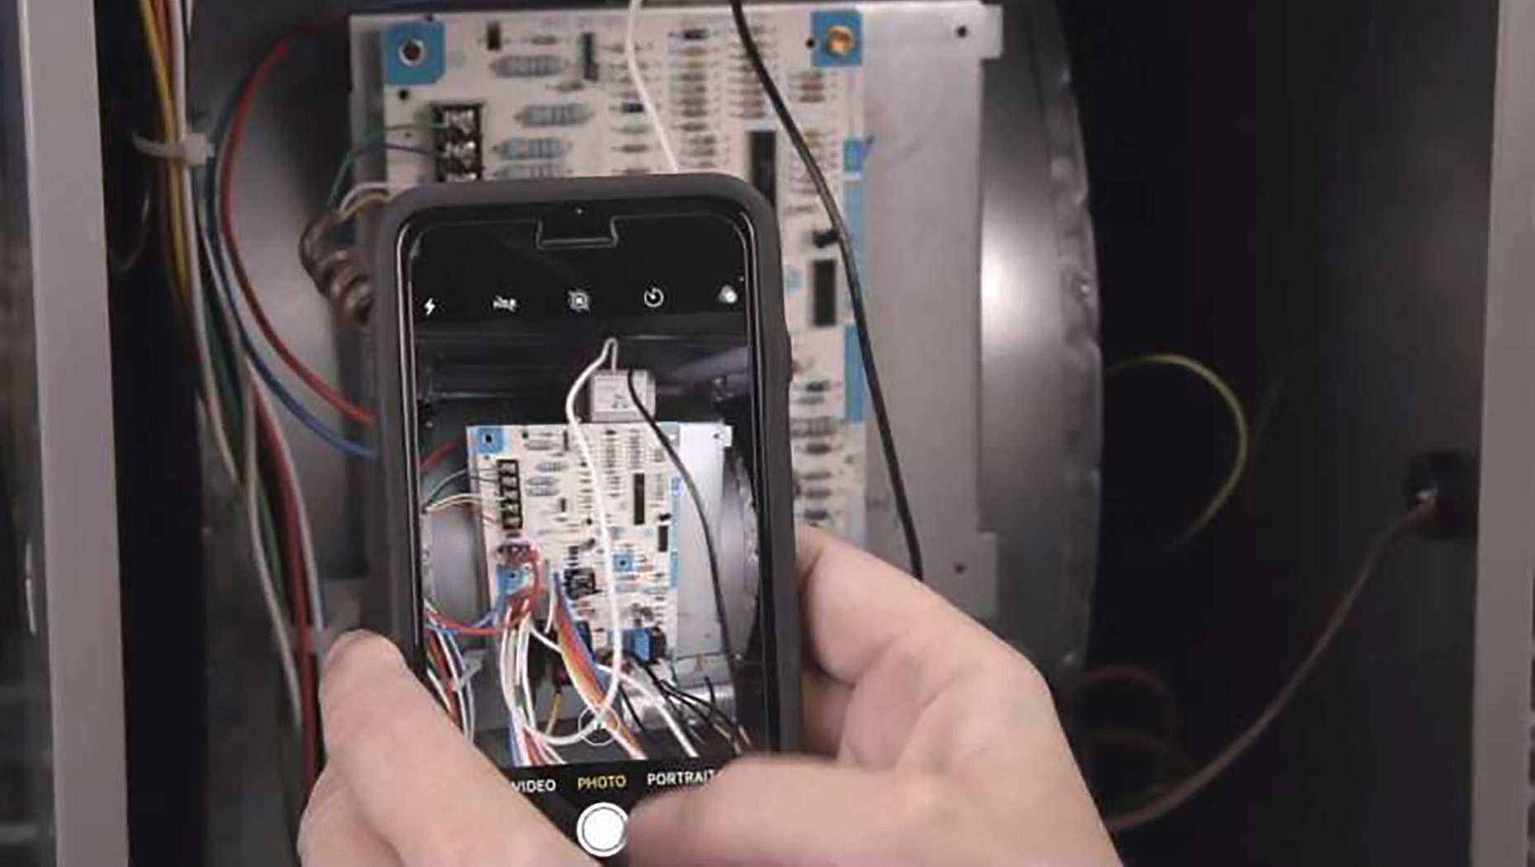
Installation – Step 3
3
Take a photo of the existing setup.

Slide 28
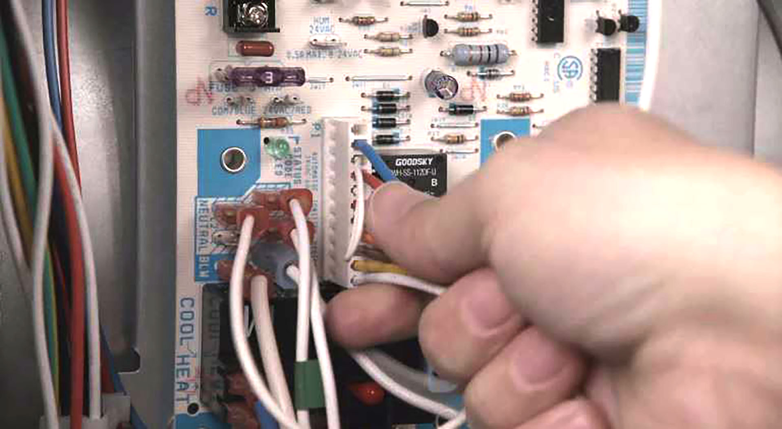
Installation – Step 4
4
Remove the Wiring:
Disconnect Thermostat Wiring
Disconnect 24v Transformer wires
Remove Carrier Inline plug
Remove 120v Power and Neutral Transformer Wires
Remove 120v Power and Neutral Wires
Disconnect 2 Pin Molex Hot Surface Inducer Plug and Neutral Wires
Remove Blower Motor Wires (Note all colors)
Remove the Board

Slide 29
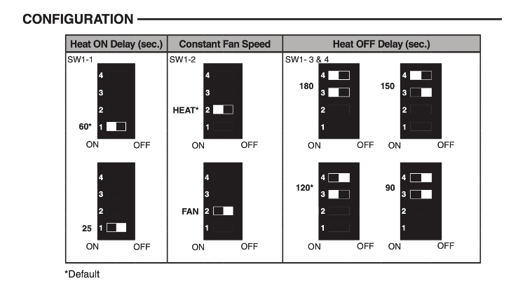
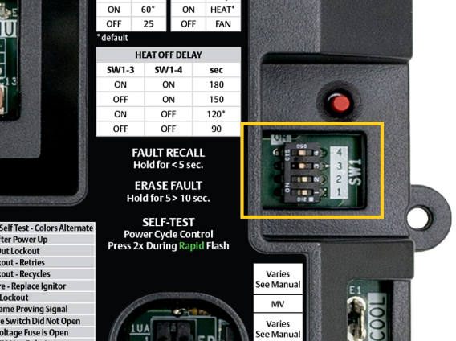
Installation – Step 5
5
Match the board’s dipswitch settings to the existing control. Use a screwdriver to push the dipswitches to their required locations according to the supplied install instructions

Slide 30
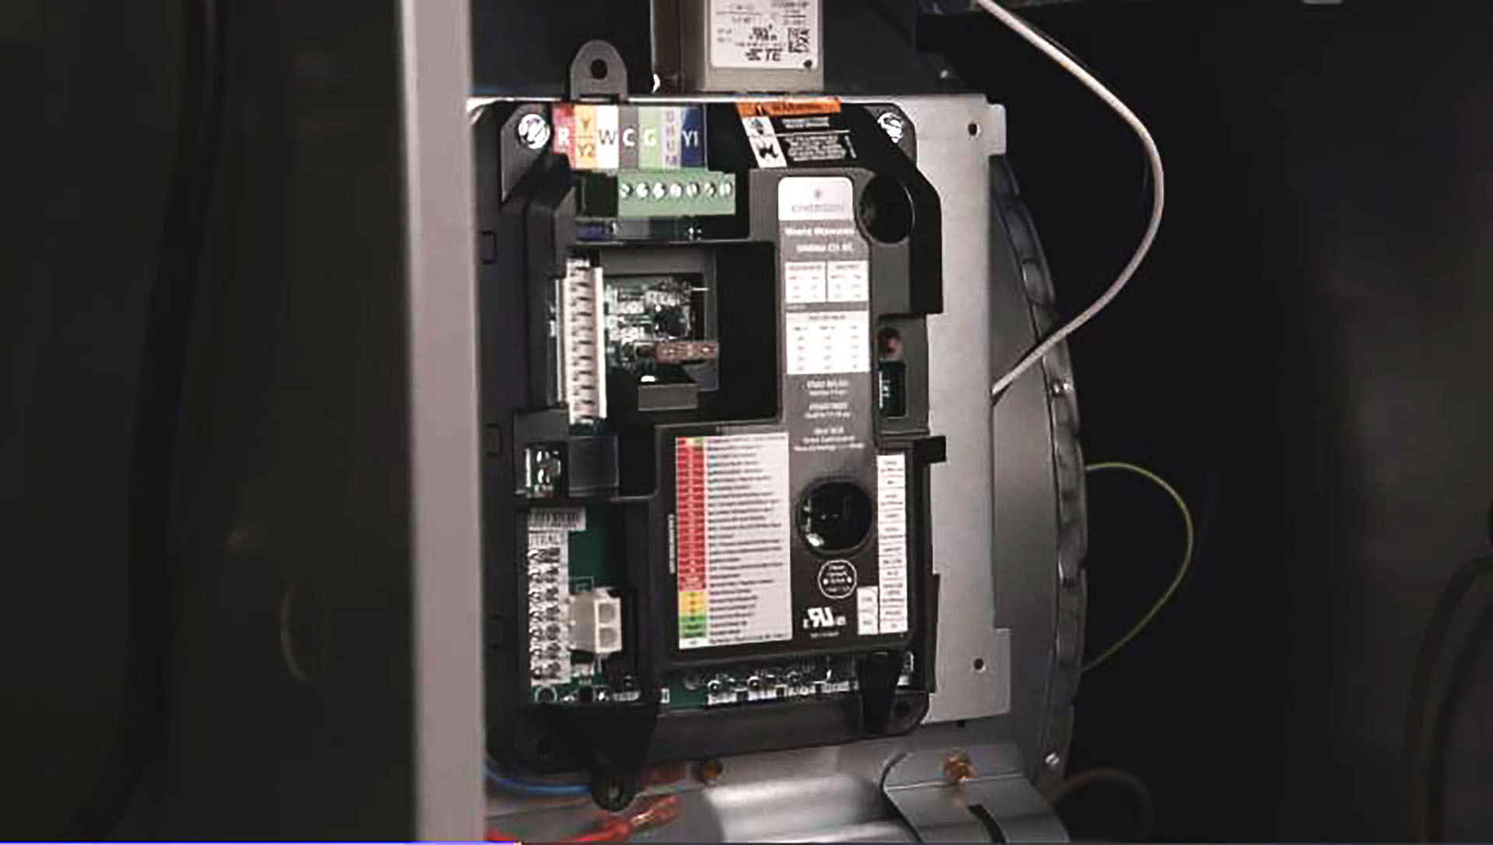
Installation – Step 6
6
Mount the new board. Select corner mounts, tab mounts, or custom, depending on application.

Slide 31
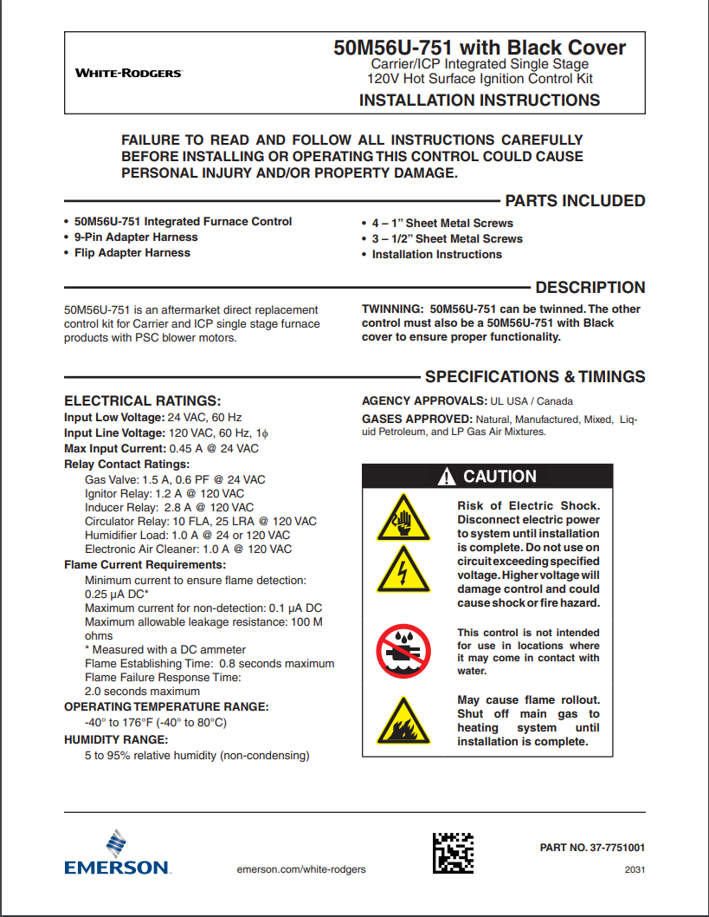
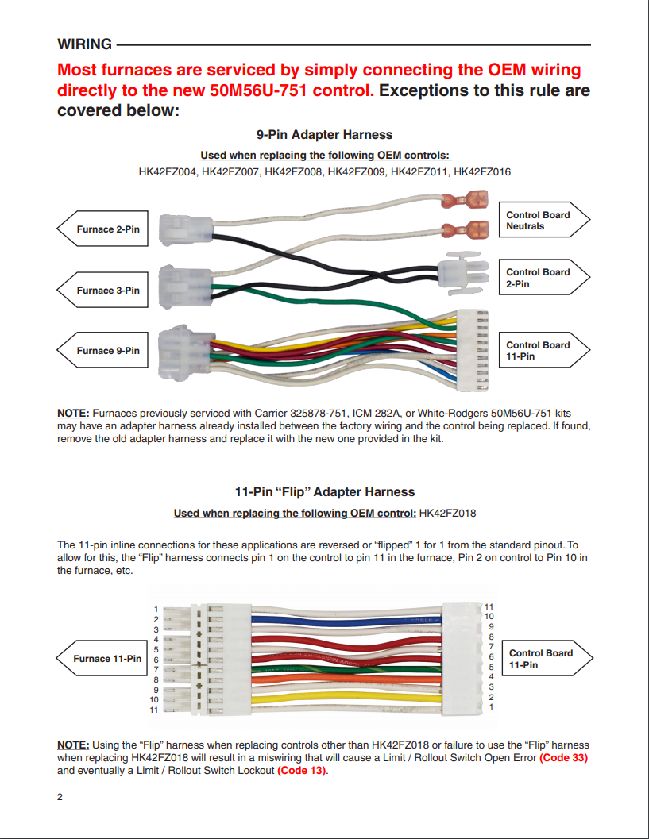
Installation – Step 7
7
Refer to instruction sheet to determine if harnesses are required for your application. Connect if required.

Slide 32
Installation – Step 8
8
Wire the New Board:
Plug in the Carrier Inline Plug
  If required, use the 9 pin adapter harness
  If required, use Flip Harness to connect directly to the control (ICP)​
Plug-in the 2 Pin Molex Hot Surface Inducer Plug and Neutral Wires​
Attach Blower Motor Wires​
Connect 120v Power and Neutral Transformer Wires
Connect 120v Power and Neutral Wires
Connect 24v Transformer wires
Connect Carrier Inline Plug
Remove T-Stat Block and install thermostat wires
  Plug Block back into Control

Slide 33
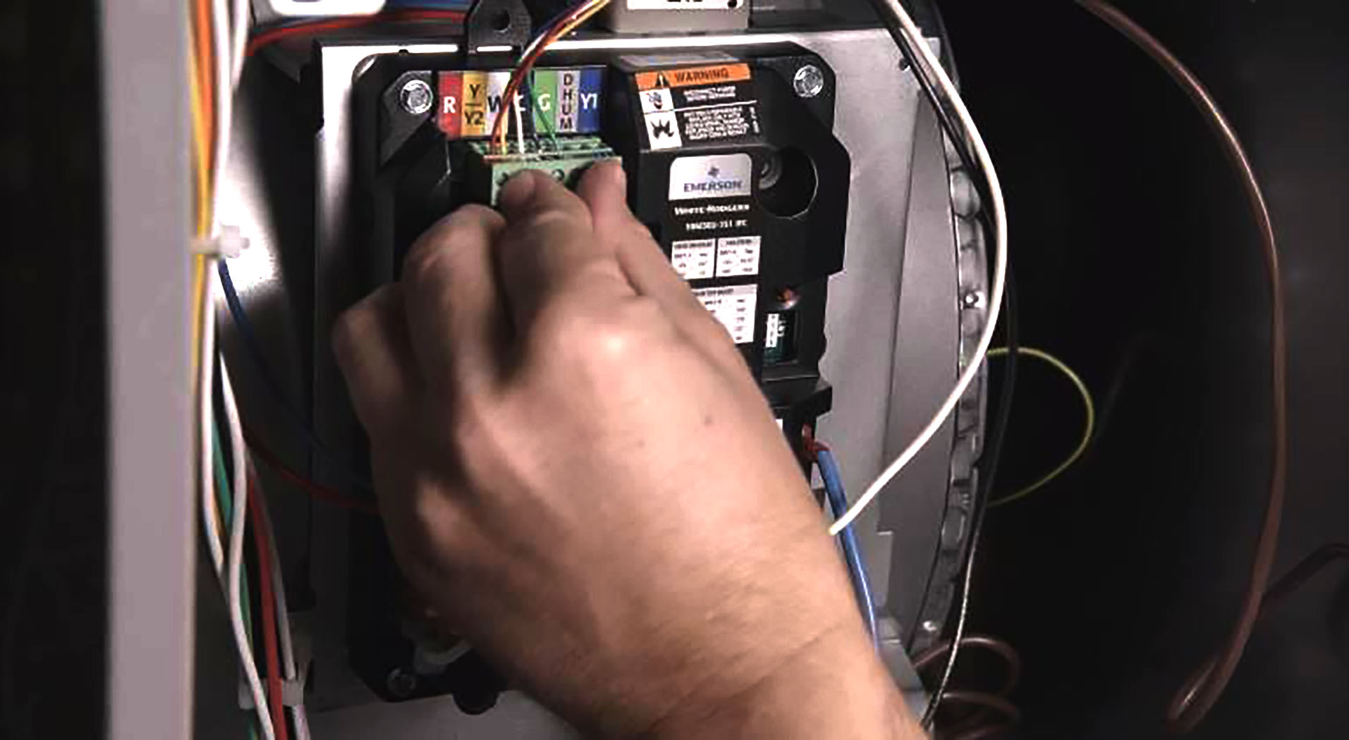
Installation – Step 9
9
Doublecheck Wires for sound connection, ensure unused blower wires are plugged into spare terminals.

Slide 34
Installation – Step 10
11
If desired, connect EAC/ Humidifier.
10
50M56U-751

Slide 35
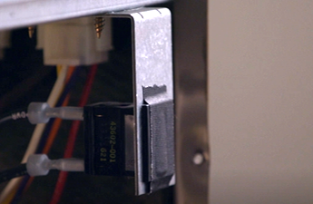
Installation – Step 11
11
Tape down door switch. Reconnect the power and gas to the furnace and enter Self-Test mode. ​

Slide 36
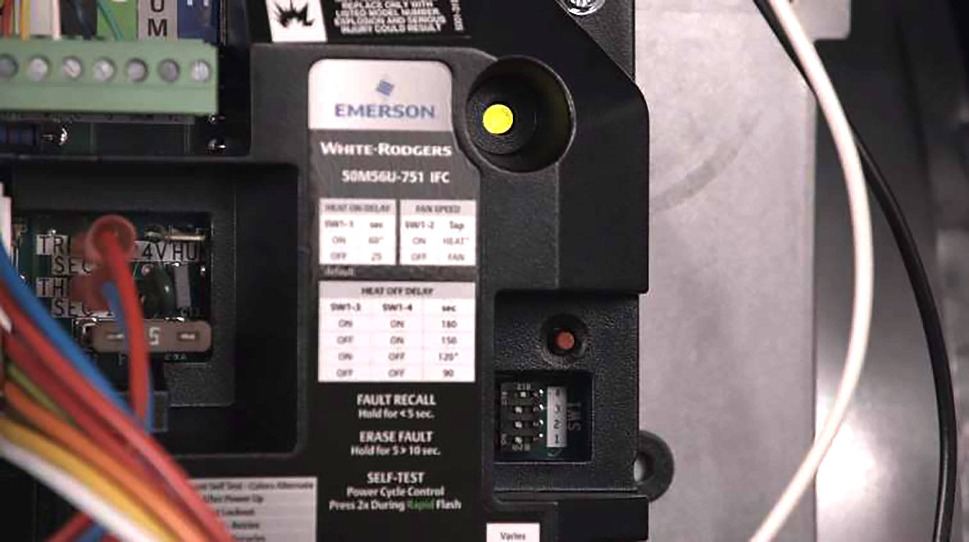
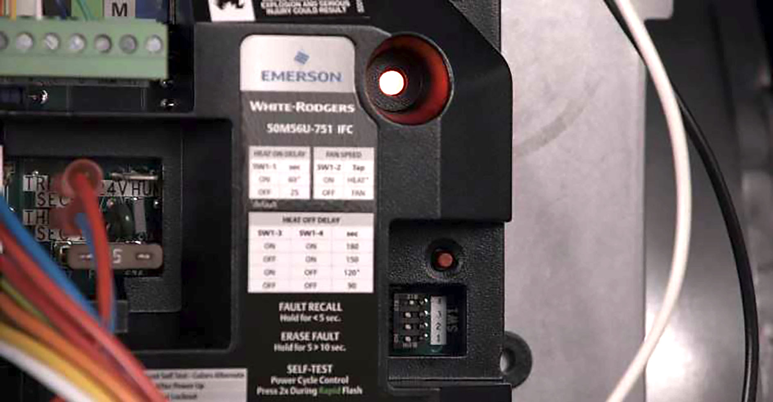
Installation – Step 12
12
Enter Self-Test mode by pressing fault recall button twice within three seconds. LED will flash last faults in red.
During Self-Test, the LED will flash Code 11 between green, amber, and red, while doing a systems check. When complete, control goes into stand-by mode.

Slide 37
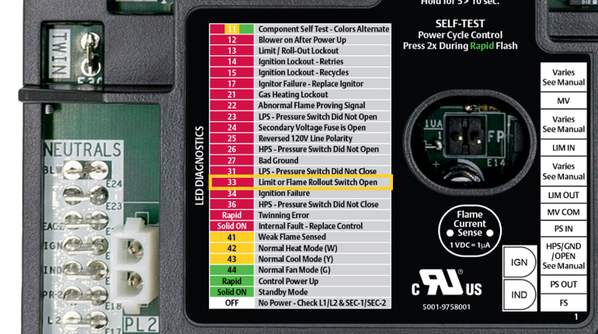
Installation – Step 13
13
Verify ignition by making a call for heat. If a fault is detected, reference the Tri-Color LED flash code against the fault code list on the control.
TECH TIP: Hold fault/recall button for 5-10 seconds to erase fault code history.

Slide 38
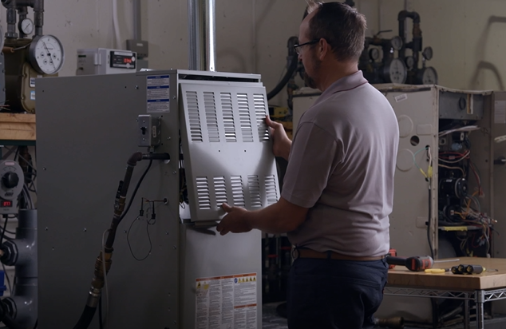
Installation – Step 14
14
Re-attach furnace panel, and you’re good to go!

Slide 39
Thank you!

Slide 40
Test Pins
Let’s build a GIF of this process from the install footage
2 pins extend from the Control Board to the surface of the Black Cover.
To Test:
The Furnace must have a call for heat and the burners producing flame.
Set a multimeter to vDC and place a meter probe on each pin.
Convert vDc to MicroAmps using a 1:1 ratio.
A good flame sense reading will be between 1.0 – 5.0 μA.
50M56U-751
R-5262
50M56U-751 Direct OEM Replacement

